Slide 1
Robust deep learning based invisible watermarking framework using saliency embedding
Ajay Sankar, Anudeep, Chethan, Mourya

Slide 2
Problem Statement
What's the Problem?
Embed a binary watermark in an image.
Watermark should be:
Invisible (no visual distortion)
Robust (resistant to noise/distortion)
Recoverable (after decoding distorted image)

Slide 3
Introduction
Invisible image watermarking must hide ownership data without introducing visible artifacts, yet most methods either become noticeable when embedding is strong enough to resist attacks or break under common distortions.
Despite advancements in invisible watermarking, a significant challenge remains in achieving robustness against both intentional attacks (like cropping, scaling, rotation) and unintentional distortions (such as compression, noise addition)
By leveraging visual saliency we embed the watermark primarily within perceptually important regions of the image – areas that capture human attention – we aim to maximize imperceptibility.
Unlike uniform or frequency-domain methods, our approach jointly trains a saliency network, encoder, decoder, and adversarial discriminator in an end-to-end fashion, ensuring the watermark remains both hidden and recoverable under real-world noise.

Slide 4
Input and Output
Input:
Natural image (CIFAR-10)
Binary watermark vector (64 bits)
Output:
Watermarked image (looks like original)
Decoded watermark (from distorted image)

Slide 5
Constraints
What are the Requirements?
Preserve image quality (PSNR/SSIM)
Embed in low-saliency regions
Resist noise and distortions
End-to-end trainable

Slide 6
Literature Review
What Has Been Done Before?
Traditional watermarking:
Frequency domain (DCT, DWT)
Spread-spectrum
DL-based methods:
HiDDeN (CVPR 2018)
DeepStamp, DWT-DNN

Slide 7
Our Contribution:
Saliency-aware learning for imperceptibility
Adversarial training for realism
Noise simulation for robustness
Lightweight & efficient architecture

Slide 8
Proposed Method
Architecture Overview
Encoder: Embeds watermark
Decoder: Extracts watermark
Discriminator: Ensures realism
SaliencyNet: Guides watermarking location

Slide 9
Method
A dedicated neural network, SaliencyNet, is trained to predict per-pixel attention maps, highlighting visually important areas in the cover image.
The inverted saliency map is concatenated channel-wise with the original cover image. This combined input is then fed into a convolutional encoder network.
The encoder processes the concatenated information to embed the 64-bit watermark imperceptibly into the image. A corresponding convolutional decoder network is designed to extract the embedded watermark from the potentially distorted watermarked image.
An adversarial discriminator network is jointly trained with the encoder and decoder. This discriminator aims to distinguish between original cover images and watermarked images, pushing the encoder to generate highly imperceptible watermarks.

Slide 10
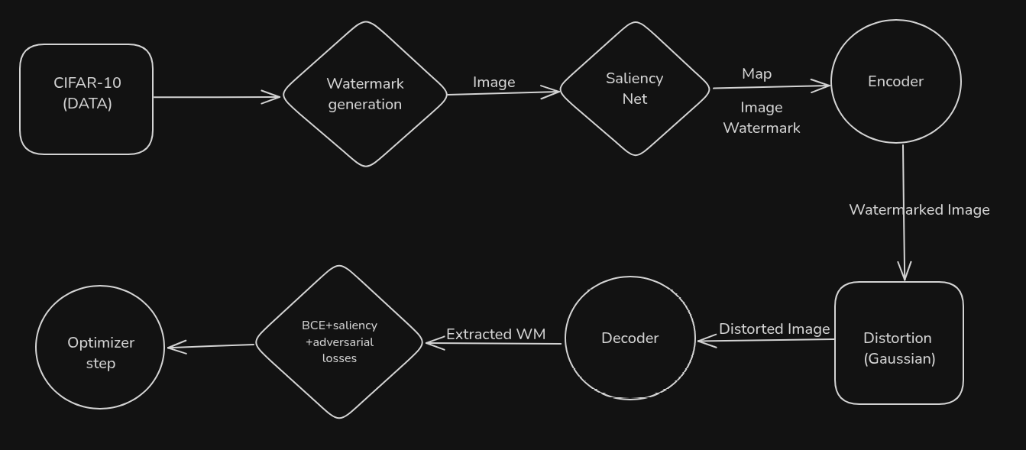
During the training process, random Gaussian noise is applied to the watermarked images. This on-the-fly simulation of a common distortion enhances the robustness of the framework against noise.
The SaliencyNet, encoder, decoder, and discriminator are trained jointly in an end-to-end fashion. This allows for the optimization of all components to achieve both high imperceptibility and strong robustness of the invisible watermark.

Slide 11
Step-by-Step Pipeline
Steps:
Predict saliency map
Embed watermark in low-saliency regions
Simulate distortion (e.g., Gaussian noise)
Decode watermark from distorted image
Use adversarial loss to preserve realism

Slide 12
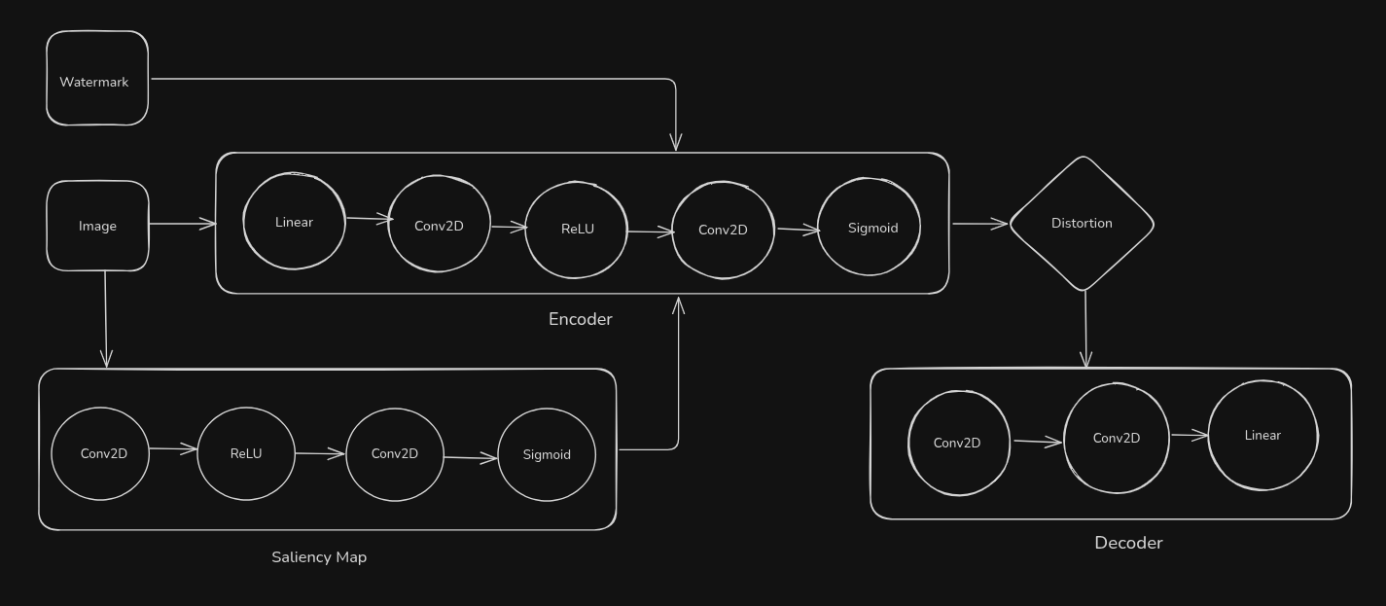
Network Architecture

Slide 13
SaliencyNet identifies low-importance regions using shallow CNN.
Encoder embeds watermark guided by saliency mask.
Decoder reconstructs watermark from distorted images.
Discriminator distinguishes between clean and watermarked images to improve realism.

Slide 14
Experiments – Setup
Datasets & Settings
CIFAR-10 (resized to 256×256)
64-bit binary watermark
Batch size: 8 | Epochs: 5
Optimizer: Adam (LR = 1e-4)
Noise: Gaussian (σ ≈ 0.05)

Slide 15
DATASET USED
Used CIFAR-10 dataset (32x32 → upscaled to 256x256).
Watermarks: Binary vectors of length 64, randomly generated.
Preprocessing:
Resize to (256x256)
Convert to PyTorch tensors

Slide 16
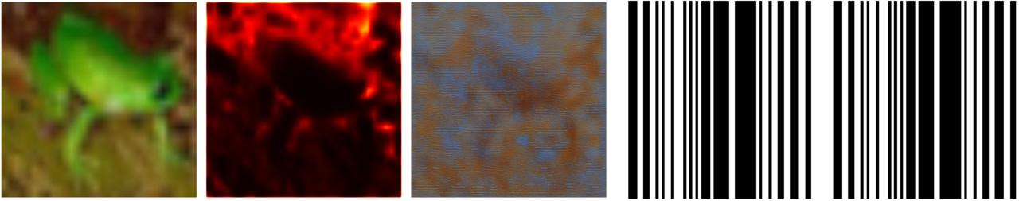
Original image
Saliency Map
Distorted image
Original WM
Extracted WM

Slide 17
Results & Figures
Training Losses (Epoch-Wise)
Epoch | Watermark Loss ↓ | Saliency Loss ↓ | Adversarial Loss ↓ | Total Loss ↓
1
2
3
4

Slide 18
Evaluation

Slide 19
Future Improvements
Use better distortion models (JPEG compression, resizing).
Experiment with different watermark lengths.
Train on higher-resolution datasets (e.g., ImageNet, CelebA).

Slide 20
Conclusion
Achieved robust and imperceptible watermarking using saliency guidance.
Decoder recovers watermark even under distortions.

